Slide 1
Tips for Developing Research Projects at CMS
Rick Andrews
Office of the Actuary
Centers for Medicare and Medicaid Services

Slide 2
Disclaimer
This lecture was designed for training purposes and is presented without warranty of any kind, either expressed or implied.
The opinions of the presenters are their own and may not reflect the Office of the Actuary, Centers for Medicare and Medicaid Services, or the Department of Health and Human Services.

Slide 3
The 7 Habits of Highly Effective People
Stephen R. Covey, 1990
Habit 3 - Put First Things First
Quadrant II Activities
CDUG – CMS Data Users Group
SUG – CMS SAS Users Group
IBUG – CMS Business Intelligence Users Group
PIDUG – Program Integrity Data Users Group
CMS Toastmasters
URGENT
NOT URGENT
IMPORTANT
1
2
Crises Deadlines Fire fighting
Pressing matters
Training
Planning Prevention Documentation
NOT
IMPORTANT
4
Distractions
Interruptions
Some meetings
Popular activities
3
Trivia
Busy work Time wasters Pleasant activities

Slide 4
Possible Resources
Federal Register
Medicare Learning Network
Medicare Coverage Database
Medicare Benefit Policy Manual
Medicare Claims Processing Manual
Research Data Assistance Center (ResDAC)
Medicare Administrative Contractors (MACs)
Medicare Payment Advisory Commission (MedPAC)

Slide 5
Environments & Systems
CMS Data Center (CDC)
IBM Mainframe
National Claims History (NCH)
Standard Analytical File (SAF)
Teradata
Integrated Data Repository (IDR)
Virtual Research Data Center (VRDC)
Oracle
Chronic Conditions Warehouse (CCW)
SAS Grid
Research Identifiable Files (RIF)
Geographic Variation Database (GVDB)

Slide 6
Specifications Example
Partial Hospitalization Program (PHP)
Intensive psychiatric treatment < 24 hours daily care
Provides treatment program not otherwise delivered in regular OP setting
Medicare Part B
Outpatient service
Provided by:
OP Department (OPD)
Community Mental Health Center (CMHC)
Levels of partial hospitalization
Level 1 = 3 services per day
Level 2 = 4+ services

Slide 7
CMS Resources
Google Search
“Partial Hospitalization Program” site:cms.gov
Take note of the “Double quotes” and site:[colon]
Medicare Learning Network
https://www.cms.gov/MLNGenInfo
Medicare Claims Processing Manual
https://www.cms.gov/Regulations-and-Guidance/Guidance/Manuals
Medicare Benefit Policy Manual
https://www.cms.gov/Regulations-and-Guidance/Guidance/Manuals
CMS Data Navigator
https://dnav.cms.gov

Slide 8
Other Resources
Federal Register
https://www.federalregister.gov
Research Data Assistance Center
https://www.resdac.org
Medicare Payment Advisory Commission
http://www.medpac.gov
Medicare Administrative Contractors
Noridian: https://med.noridianmedicare.com
Novitas: https://www.novitas-solutions.com

Slide 9
Additional CMS Links for Data Analysis
Research, Statistics, Data, and Systems
Files For Order General Information
Medicare Statistical Supplement
CMS Program Statistics
Rates and Statistics
Trustees Report

Slide 10

MLN Article and Processing Manual
MLN Matters® Article: SE1512
https://www.cms.gov/Outreach-and-Education/ Medicare-Learning-Network-MLN/MLNMattersArticles/ Downloads/se1512.pdf
CMS reminds hospitals and CMHCs that provide PHP services to follow existing claims coding requirements given in the “Medicare Claims Processing Manual,”
Chapter 4, section 260
http://www.cms.gov/Regulations-and-Guidance/ Guidance/Manuals/Downloads/clm104c04.pdf

Slide 11
Medicare Claims Processing Manual
https://www.cms.gov/Regulations-and-Guidance/Guidance/Manuals
Chapter 4 - Part B Hospital
Includes Inpatient Hospital Part B and
Outpatient Perspective Payment System (OPPS)
Section 260 - Outpatient Partial Hospitalization Services
260.1 - Special Partial Hospitalization Billing Requirements
Hospitals
Critical Access Hospitals
Community Mental Health Centers
Must report Revenue Center and HIPPS Codes

Slide 12
Medicare Coverage Database
https://www.cms.gov/medicare-coverage-database/
Go to QUICK SEARCH (right hand side)
Select NATIONAL AND LOCAL COVERAGE DOCUMENTS
Select ALL STATES
Keywords are “Partial Hospitalization”
Click “SEARCH BY TYPE”
Under Medicare Coverage Documents click ARTICLES
Click L37633, “Partial Hospitalization Program”
Contributed by Russell Hendel, CM

Slide 13


Medicare Administrative Contractors
Noridian
https://med.noridianmedicare.com
Novitas
https://www.novitas-solutions.com
*Not all MACs are displayed

Slide 14
Federal Register
Google Search
partial hospitalization program php apc updates for CY 2017
Final Rule: Hospital Outpatient Prospective Payment System
https://www.federalregister.gov/documents/2017/11/13/2017-23932/ medicare-program-hospital-outpatient-prospective-payment-and-ambulatory-surgical-center-payment
CNTL+F (find)
php apc update
Effective January 1, 2011
APCs (0172, 0173, 0175, 0176)
Effective January 1, 2016
APCs (5851, 5852, 5861, 5862)
Effective January 1, 2017
APCs (5863, 5853)

Slide 15
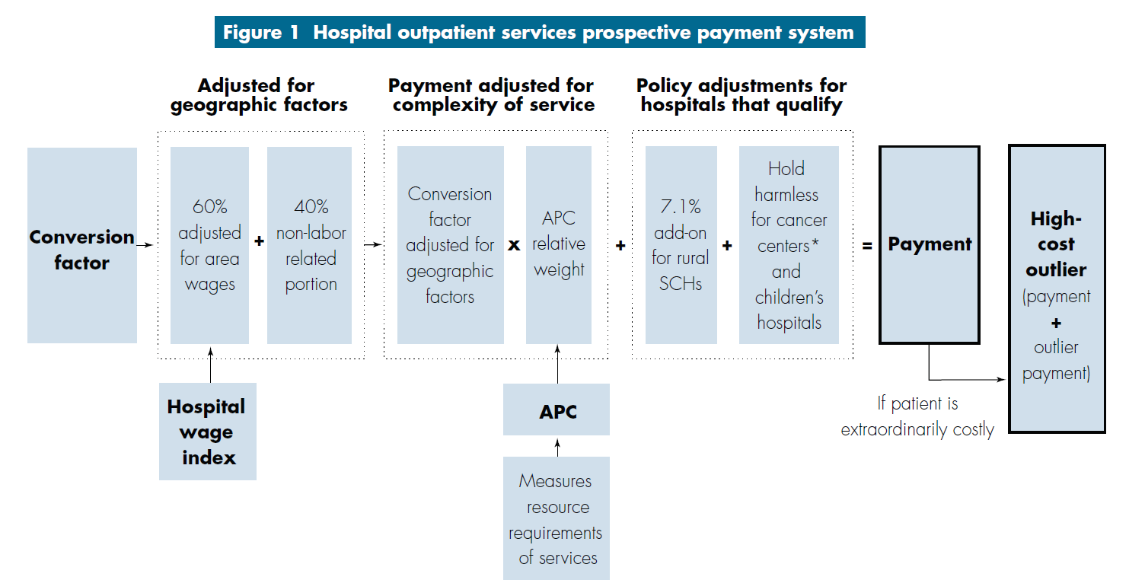
Medicare Payment Advisory Commission (MedPAC)
http://www.medpac.gov/-research-areas-/hospitals

Slide 16
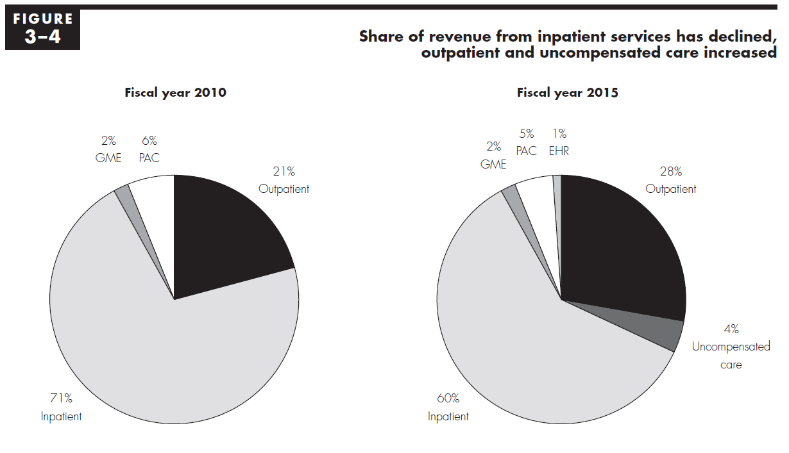
Example: MedPAC Report to Congress
http://www.medpac.gov/docs/default-source/reports/ mar17_medpac_ch3.pdf
Note: March report shows estimated profit margins and other quality measures

Slide 17


SAS Training Course
Administrative Healthcare Data
U.S. Healthcare System
A "30-thousand-foot" view of the industry
Payment systems, payers, and providers
Healthcare Data Origins
Institutional (CMS-1450 claim form)
Professional (CMS-1500 claim form)
Prescription drug data
837 electronic claims
Other Topics
Medical Claim Codes
Post-Adjudication Data
Member Files
Provider Data
Fraud and Abuse
Second Edition
First Edition
https://support.sas.com/edu
https://www.sas.com/store/books

Slide 18
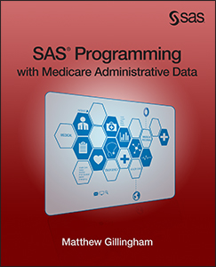
SAS Programming with Medicare Administrative Data
Sources of Claims Data at CMS
Data Extract System (DESY)
Research Data Distribution Center (RDDC)
Virtual Research Data Center (VRDC)
Integrated Data Repository (IDR)
CMS Data Center (CDC)
Primarily based on Chronic Conditions Warehouse (CCW)
https://www.sas.com/store/books

Slide 19
PHP Spec Recap - Claim Codes Needed
Claim Type Code
APC/HIPPS Code
Revenue Center Code

Slide 20
Revenue Center Details
Health Insurance Prospective Payment System (HIPPS)
Ambulatory Payment Classification (APC)
Applicable from 2011 - 2015
HIPPS/APC Code | Description
0172 | Level I Partial Hospitalization - 3 services for CMHCs
0173 | Level II Partial Hospitalization - 4 or more services for CMHCs
0175 | Level I Partial Hospitalization - 3 services for Hospital-based PHPs
0176 | Level II Partial Hospitalization - 4 or more services for Hospital-based PHPs

Slide 21
Acceptable PHP Revenue Codes
Revenue Code | Description
0250 | Drugs and Biologicals
043X | Occupational Therapy
0900 | Behavioral Health Treatment/Services
0904 | Activity Therapy
0914 | Individual Therapy
0915 | Group Therapy
0916 | Family Therapy
0918 | Testing
0942 | Education Training

Slide 22
Desired Statistics
For each APC/HIPPS Code
Utilization Days
Cost Sharing Amount
Claim Payment Amount
Median Number of Episodes
Number of Unique Patients

Slide 23
Fee-For-Service (FFS) Data Systems
National Claims History (NCH)
Collects FFS utilization data
Medicare beneficiaries
Part A - Hospital Insurance (HI)
Part B - Supplemental Medical Insurance (SMI)
Standard Analytical Files (SAF)
Final action files created for ease of use
Integrated Data Repository (IDR)
Initially created to analyze Part D prescription drug data
Now contains Parts A, B, C, and D
Chronic Conditions Warehouse (CCW)
Initially created to analyze chronic conditions
Now contains Parts A, B, and D
Typically accessed using the Data Extract System (DESY)

Slide 24
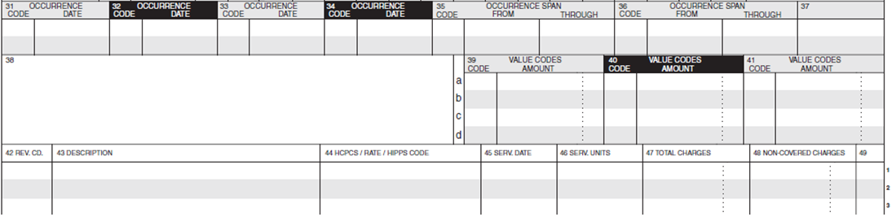
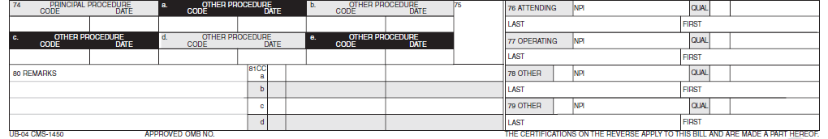
CMS Form 1450 - Institutional Claim
Rev. Center
Procedures
Provider

Slide 25
NCH – Institutional File Layout
NCH Variable Length Flat File Record Layout (Form CMS-1450)
Claim # | Header | Trailers
1 | Fixed Portion | Edit |  | Patch |  | Demo | Diag | Proc |  | Cond | Occur |  | Span | Value | Rev Center
2 | Fixed Portion | Edit | Patch | MCO | Diag |  | Proc |  | Cond | Occur | Span | Value | Rev Center
Example Data Model
Revenue Center Transposed
Rev Line | REV CNTR | APC HIPPS | CHRG AMT | PMT AMT
1
2
3
--
43
44
45
Edit
Proc
Patch
Cond
An institutional claim can have up to 45 revenue centers per record and up to 10 segments
(450 revenue centers per claim).
MCO
Header
Span
Demo
Value
Diag
Rev Center

Slide 26
NCH Record Information Facility (RIF)
CMS Web Site
https://www.cms.gov/Research-Statistics-Data-and-Systems/ CMS-Information-Technology/DataAdmin
CMS Mainframe
READY prompt
EX 'MV00.@BEB3002.CLIST(RIF)'
********************************************************
* Welcome to the Record Information Facility (RIF) *
********************************************************
01 Claims and Utilization Data
02 Enrollment and Eligibility Data
03 Combined Claims and Enrollment Data
04 Provider of Services Data
05 Medicaid Data
06 Reference/Resource Data

Slide 27
NCH Claim Type Code
NAME LENGTH BEG END CONTENTS
-----------------------------------------------------------
7. NCH Claim Type Code
2 7 8 CHAR
The code used to identify the type of claim
record being processed in NCH.
DB2 ALIAS : NCH_CLM_TYPE_CD
SAS ALIAS : CLM_TYPE
STANDARD ALIAS : NCH_CLM_TYPE_CD
CODE TABLE : NCH_CLM_TYPE_TB

Slide 28
NCH Claim Type Code Table
NCH_CLM_TYPE_TB
10 = HHA claim
20 = Non swing bed SNF claim
30 = Swing bed SNF claim
40 = Outpatient claim
50 = Hospice claim
60 = Inpatient claim
61 = Inpatient 'Full-Encounter' claim
62 = Medicare Advantage IME/GME Claims
63 = Medicare Advantage (no-pay) claims
64 = Medicare Advantage (paid as FFS) claims
71 = RIC O local carrier non-DMEPOS claim
72 = RIC O local carrier DMEPOS claim
81 = RIC M DMERC non-DMEPOS claim
82 = RIC M DMERC DMEPOS claim

Slide 29

Research Data Assistance Center (ResDAC)
https://www.resdac.org

Slide 30
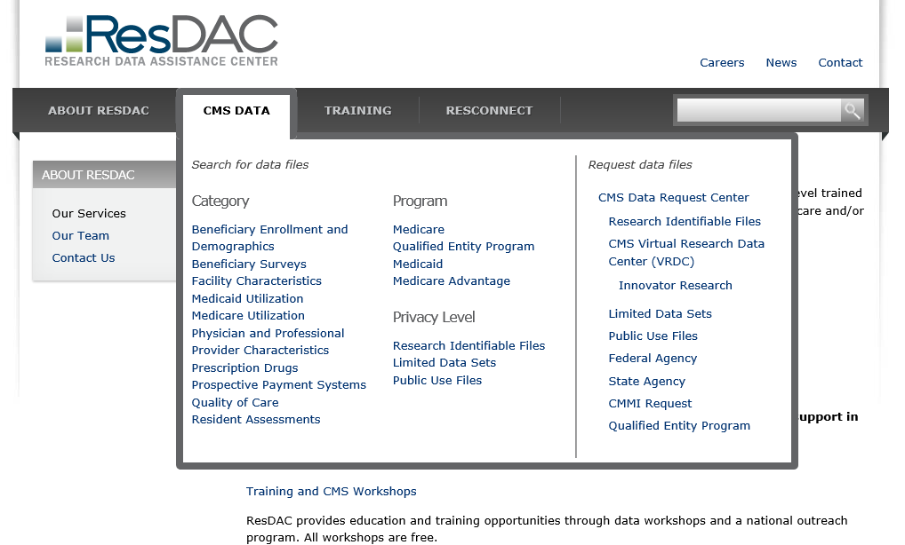

Slide 31
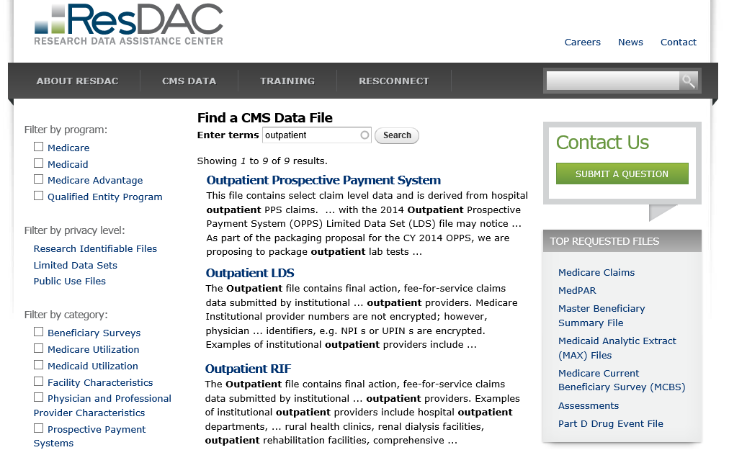

Slide 32
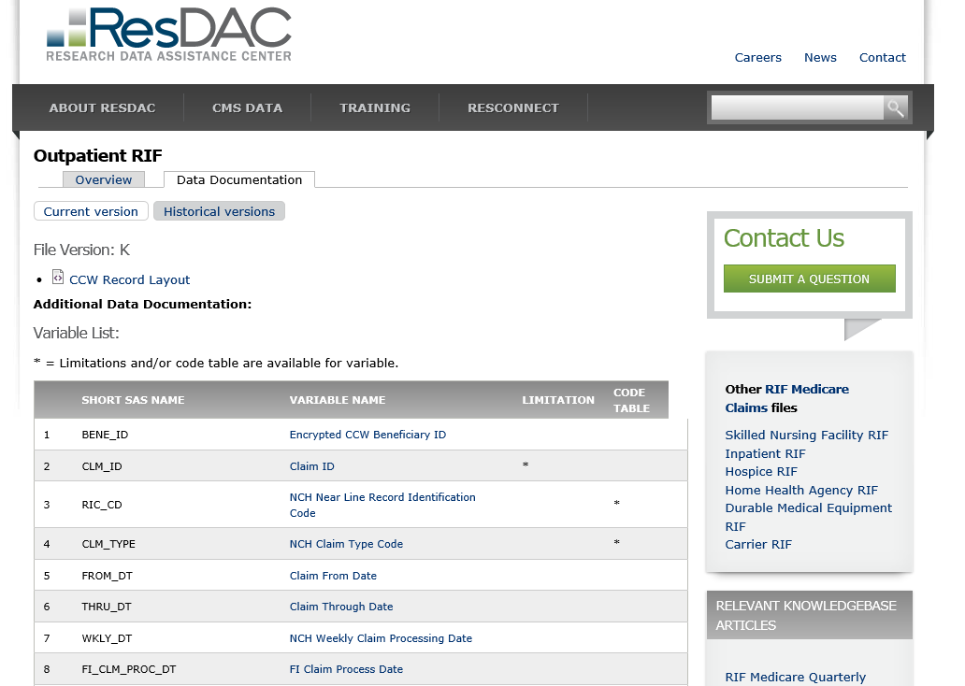

Slide 33
ResDAC Claim Type Code Table
https://www.resdac.org/cms-data/variables/nch-claim-type-code
Short SAS Name: CLM_TYPE
Long SAS Name: NCH_CLM_TYPE_CD
Used to identify the type of claim being processed in NCH
Institutional | Inpatient | Part A | 60
 | Skilled Nursing | Part A | 20,30
 | Hospice | Part A | 50
 | Home Health | Part A or B | 10
 | Outpatient | Part B | 40
Professional | Physician | Part B | 71,72
 | Medical Equipment | Part B | 81,82

Slide 34
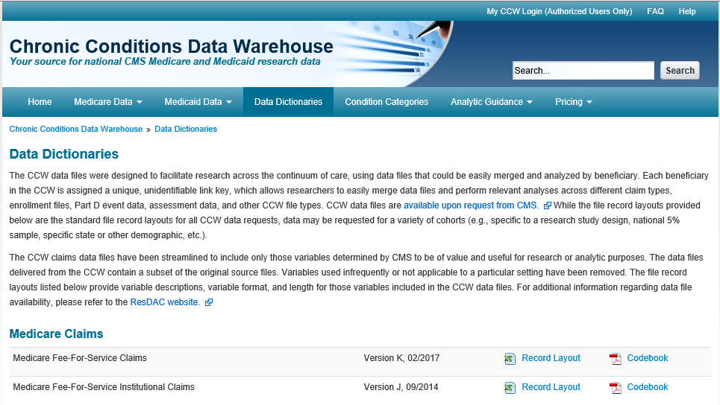
https://www.ccwdata.org

Slide 35
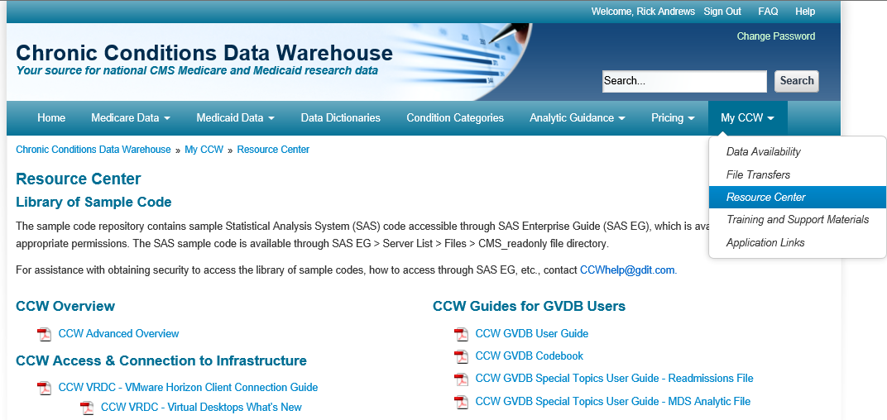
CCW Resource Center

Slide 36
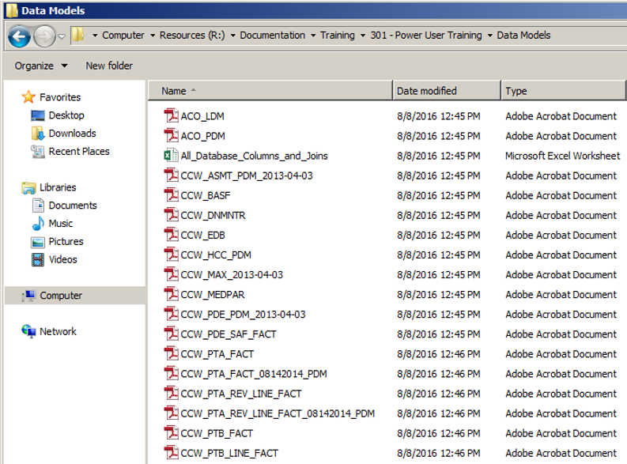
CCW Data Dictionaries & Data Models
R:\Documentation\Training\301 - Power User Training\Data Models
Available at VRDC
Used for Oracle Tables

Slide 37
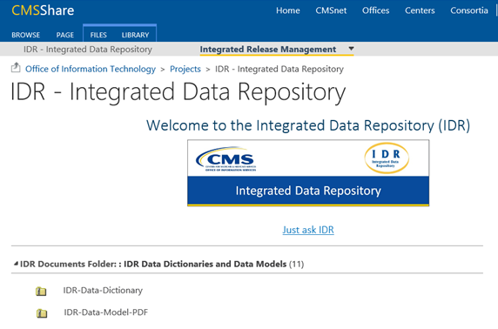
IDR Data Dictionaries & Data Models
https://share.cms.gov/office/ois/Projects/IDR/SitePages/Home.aspx
CMS SharePoint Site
Used for Teradata Tables

Slide 38
IDR Data Dictionary User Interface
Report Accessibility
CMS Network
https://portal.cms.cmsnet
Enterprise Portal
https://portal.cms.gov
EUA Job Code
IDR_DD_MSTR_PROD_WEB
Data Refresh Frequency
Monthly Refresh
Tuesday after the 10th of each month.

Slide 39
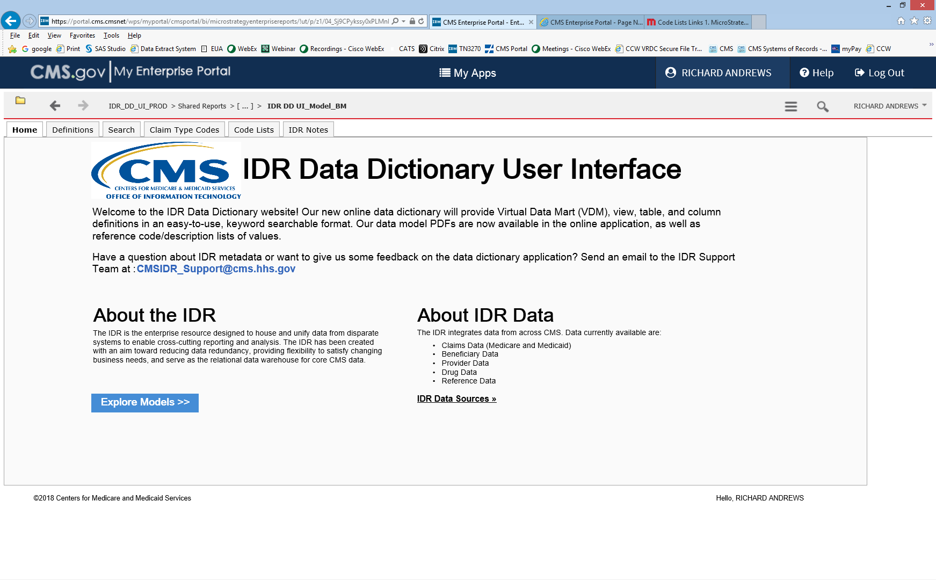

Slide 40
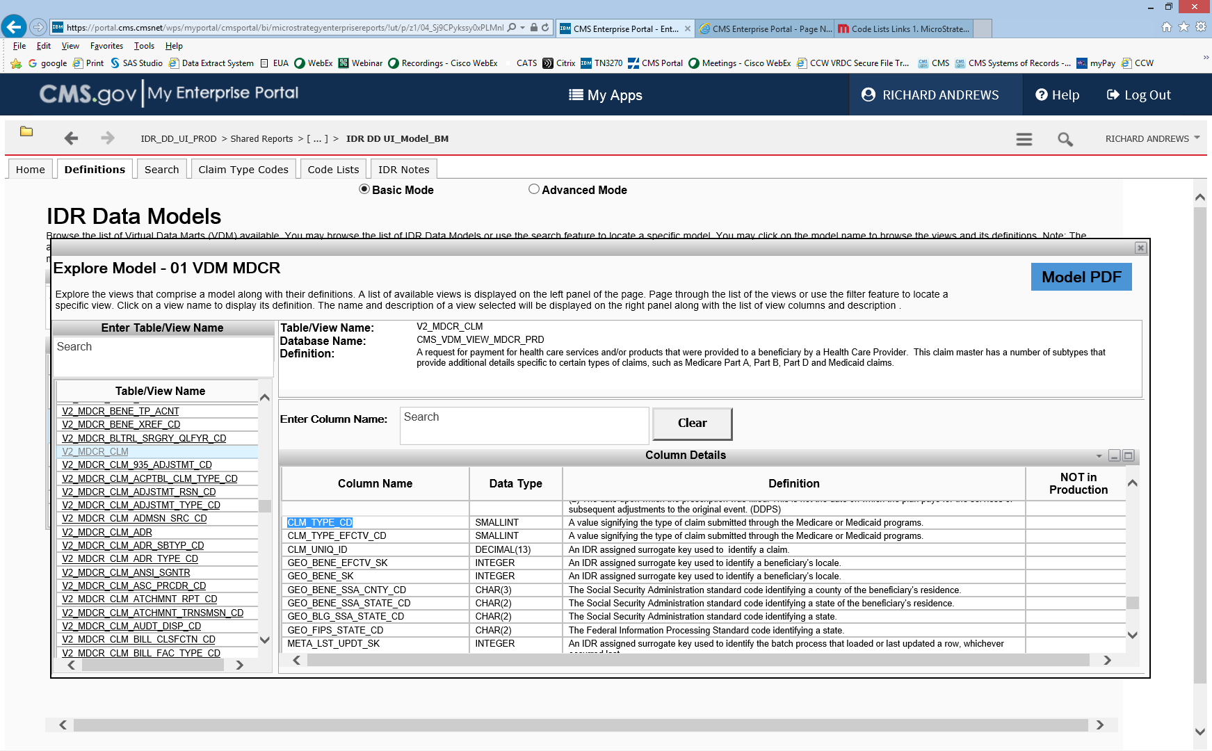

Slide 41
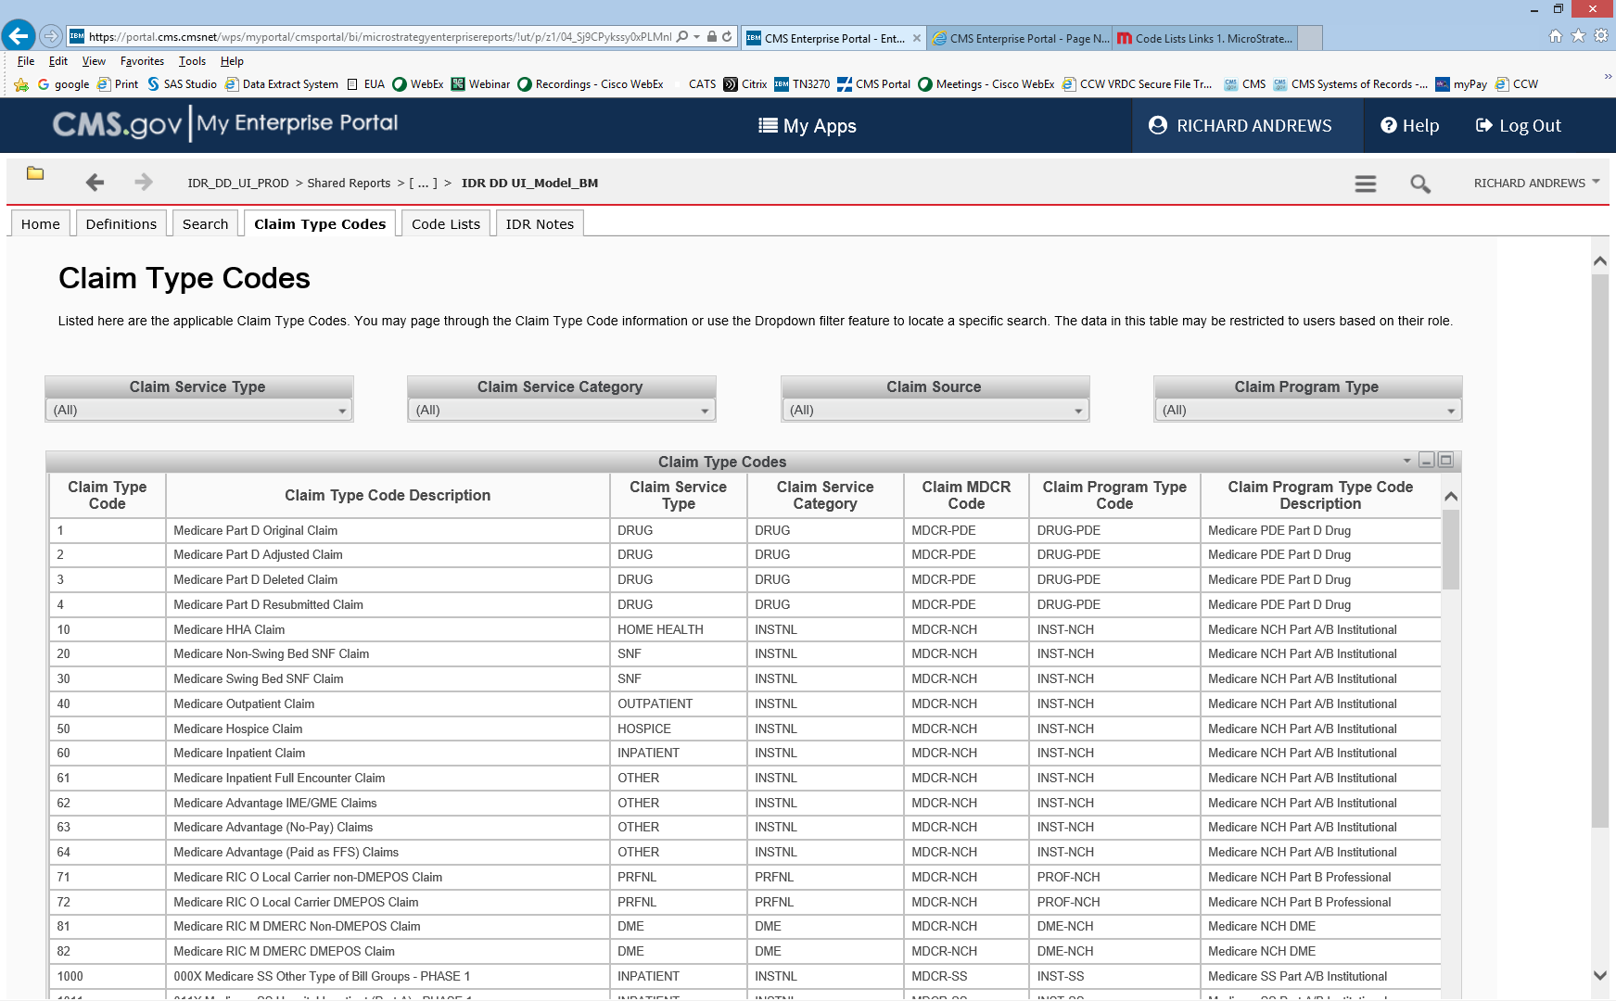

Slide 42
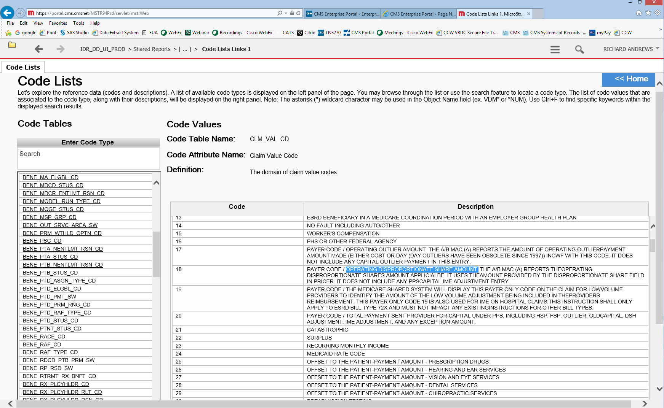

Slide 43
Flow of NCH Data
Located on CMS Mainframe
99 variable length flat (text) files per year
M1 - Temporary monthly files by state
A6 - Claims with a six month run-out (~99% complete) by state
M3 - Trickle claims outside the 18-month window by state
MP - Anomaly claims such as DME
Weekly Process Date in a prior year than Claim Thru Date
Example Mainframe NCH Data Sets
P#UTL.#NCHP.CRT.NLK.M1.Y10.S01B.G0018V00 | 18th monthly claim file by state
P#UTL.#NCHP.CRT.NLK.A6.Y10.S01B | Quarter 6 representing the 18-month window
P#UTL.#NCHP.CRT.NLK.M3.Y10.S01B.G0030V00 | 30th monthly trickle file by state
P#UTL.#NCHP.CRT.NLK.MP.PRIOR.DME.Y10.S01B | DME anomaly file

Slide 44
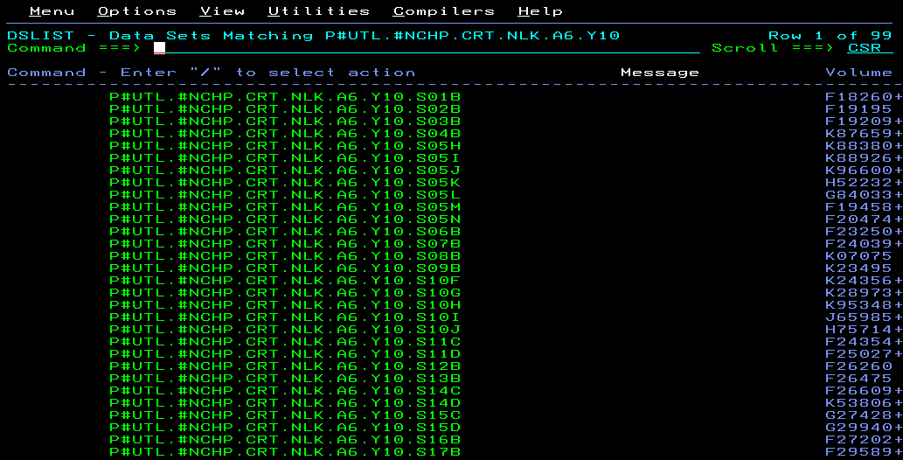
NCH A6 Flat File Examples
99 Segments
Separated by State

Slide 45
SAF (Final Action) Files
“A6” records are output to the “18-month SAF”
Note that physician data are only a 5% sample
Example Mainframe SAF Data Sets
P#UTL.#SAFP.CRT.ANK.FA.DMEM.Y10.#1106 | Part B DMEPOS claim (processed by DME MAC)
P#UTL.#SAFP.CRT.ANK.FA.DMEO.Y10.#1106 | Part B DMEPOS claim (processed by A/B MAC)
P#UTL.#SAFP.CRT.ANK.FA.HHA.Y10.#1106 | Part A home health agency claim
P#UTL.#SAFP.CRT.ANK.FA.HSP.Y10.#1106 | Part A hospice claim
P#UTL.#SAFP.CRT.ANK.FA.INP.Y10.#1106 | Part A inpatient claim
P#UTL.#SAFP.CRT.ANK.FA.OUT.Y10.#1106 | Part B outpatient claim
P#UTL.#SAFP.CRT.ANK.FA.SNF.Y10.#1106 | Part A skilled nursing facility claim
P#UTL.#SAFP.CRT.ANK.FA.P-S.PC5.Y10.#1106 | 5% Part B physician/supplier claim
Data usually obtained from the Data Extract System (DESY)
DESY_Support@cms.hhs.gov

Slide 46
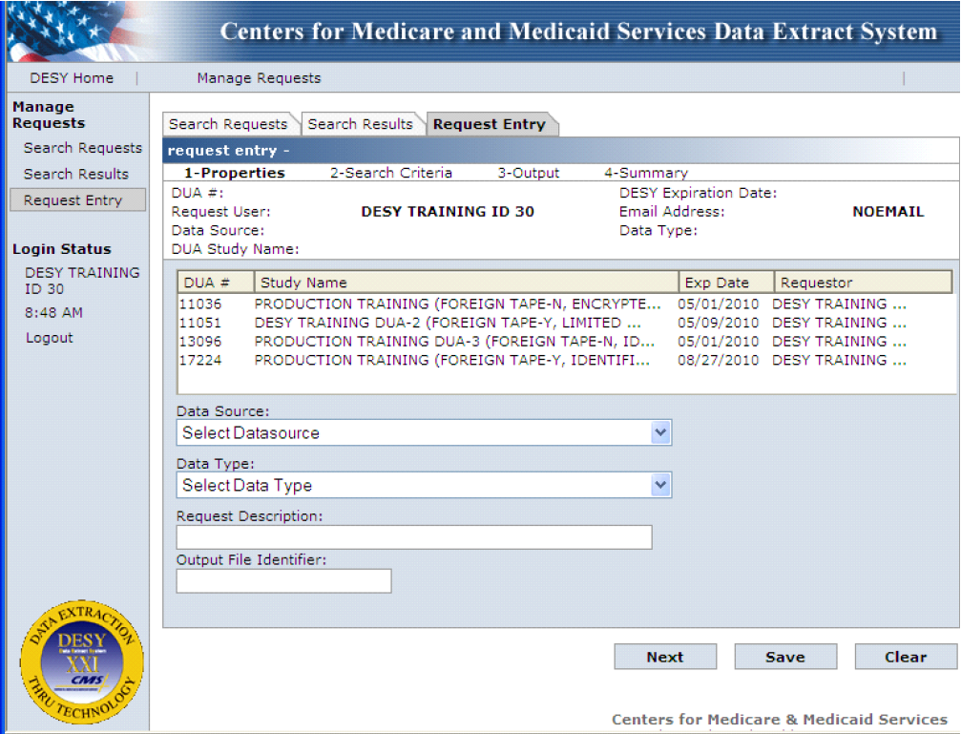
Data Extract System (DESY)
http://www.cms.gov/desy
Results stored on the mainframe in SAF format

Slide 47
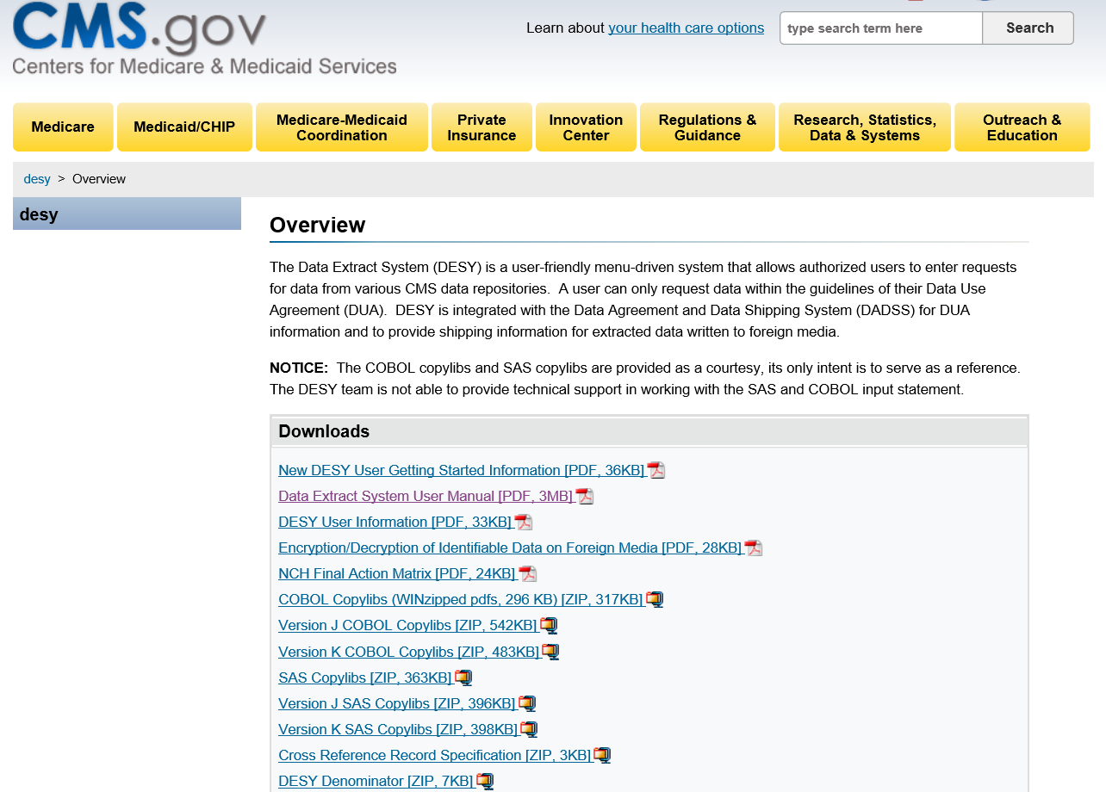
COBOL CopyBooks and SAS Input Statements
https://www.cms.gov/Research-Statistics-Data-and-Systems/CMS-Information-Technology/desy

Slide 48

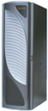



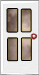
CMS Data Center (CDC)
National Claims History (NCH)
Mainframe Platform
Integrated Data Repository (IDR)
Teradata Platform
Access Methods
Mainframe Channel
Desktop Computer
Enterprise Business Intelligence (EBI)
Virtual desktop (Citrix)
SAS Enterprise Guide
CMS Data Center
Channel
Network
Mainframe
Business Intelligence

Slide 49
CDC Web-based Tools
SAS Enterprise Business Intelligence (EBI)
Web Report Studio
SAS Studio
SAP Business Objects
MicroStrategy
IBM Cognos

Slide 50
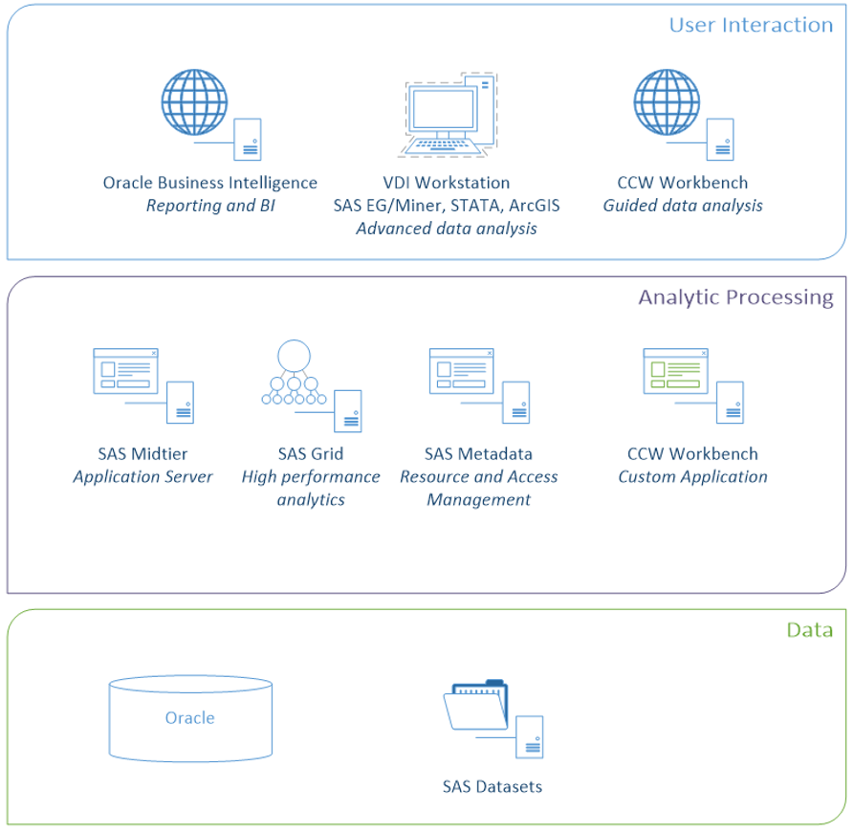
Virtual Research Data Center (VRDC)
Chronic Conditions Warehouse
Oracle BI
Stata
ArcGIS
SAS Grid
SAS Enterprise Guide
SAS Enterprise Miner
Warrenton Data Center
Virtual Desktop (VMWare)

Slide 51
IDR Virtual Data Mart Inventory (partial)
VDM | Database | Business Purpose
MDCR View | CMS_VDM_VIEW_MDCR_PRD | Single largest VDM to support ad hoc reporting needs for Medicare Parts A, B, C, and D (632 Views)
MDCR Access Layer | CMS_VDM_VIEW_SMNTC_PRD | User-friendly subset of MDCR, organized in a dimensional model requiring fewer joins (20 Views)
Access Layer Reference | CMS_VDM_VIEW_RFRNC_AL_PRD | New global addition which supports users requiring reference or ‘look-up’ information (62 Views)
OnePI | CMS_VDM_VIEW_OPI_PRD | Supports CPI, focused on fraud detection
DDPS | CMS_VDM_VIEW_DDPS_PRD | Supports Part D standard reports, replaced DDPS Phase I legacy PDM
DCEP | CMS_VDM_VIEW_DCEP_PRD | Supports beneficiary analysis, replaced MIIR legacy PDM
FNDR | CMS_VDM_VIEW_FNDR_PRD | Supports users that load custom data to IDR for analytics

Slide 52
CCW SAS Data Set Inventory (partial)
Reference | Database | Business Purpose
GV_BENE GV_CLAIM GV_RTIME GV_SRVC | Geographic Variation Database | Suite of SAS analytic files that combine basic Medicare beneficiary and FFS claims data that make it easier to study geographic variation
RIF | Research Identifiable Files | Contains final action fee-for-service claim files
MBSF | Master Beneficiary Summary File | Contains demographic entitlement and enrollment data for beneficiaries
MEDPAR | Medicare Provider Analysis and Review | Contains inpatient hospital and/or skilled nursing facility (SNF) final action stay records
MCBS | Medicare Current Beneficiary Survey | Continuous, multipurpose survey of a nationally representative sample of the Medicare population
MAX | Medicaid Analytic eXtract | Person-level data files on Medicaid eligibility, service utilization, and payments

Slide 53
IDR - FFS Claims
Teradata Data Repository
2006 thru current
All FFS claims downloaded on a weekly basis
Final Action indicator is updated every week
Medicare “View” Virtual Data Mart (VDM)
632 views
Very flexible, though more difficult to use
Mimics underlying physical tables
Access Layer VDM
21 views
Simplified structure for ease of use
Meant to address 90% of business needs

Slide 54
VRDC/CCW - FFS Claims
Oracle Data Warehouse ← Used by “Power Users”
1999 thru current
Contains all NCH/FFS claims in a claims family
Claims after 12 months are marked as “late-arriving”
Research Identifiable Files (RIF)
1999 thru current segmented by month with a 12 month run-out
Split by 7 claim types (IP, OP, SNF, HHA, Hospice, Physician, and DME)
1 calendar year: 7 claim types x 12 months = 84 SAS data sets
Geographic Variation Database (GVDB)
Includes standardized claim payments based on geography
2005 thru 2017 segmented by year with a 12 month run-out
Contains a subset of variables split by Part A and Part B services

Slide 55
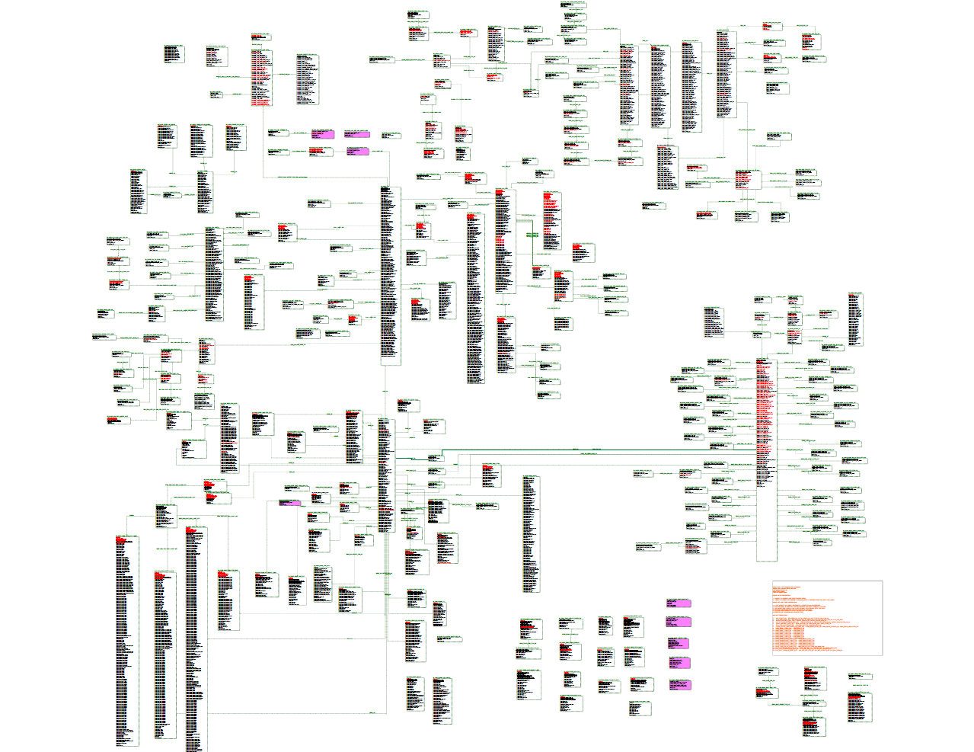
Data Model - IDR Medicare View
632 views
Third Normal Form
Highly Normalized

Slide 56
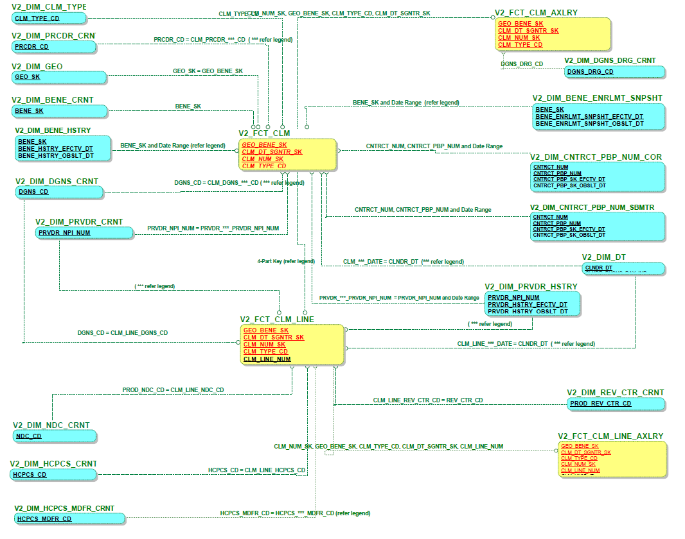
Data Model – IDR Access Layer
21 views
Mainly a Star Schema
Underlying Data in Third Normal Form
Somewhat Normalized

Slide 57
Third Normal Form Example
Non-3NF Representation
3NF Equivalent
http://ideal.ece.utexas.edu/pubs/pdf/2014/graph_database_in_healthcare.pdf

Slide 58
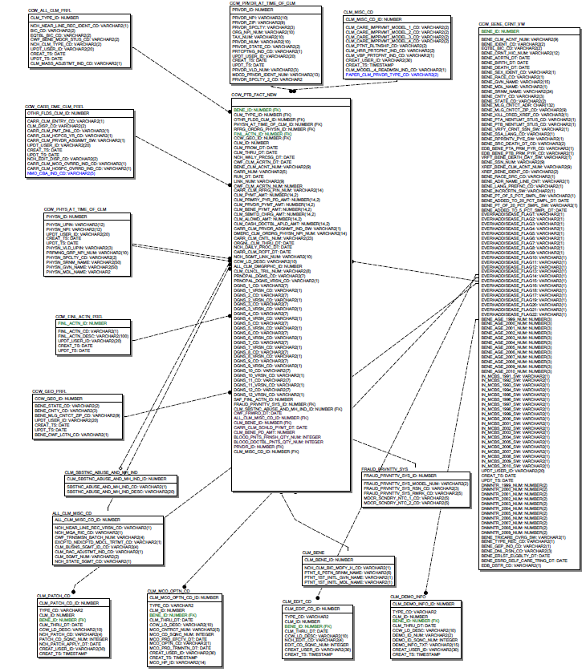
Data Model – CCW Oracle Tables
CCW_PTA_FACT
CCW_PTA_REV_LINE_FACT
CCW_PTB_FACT
CCW_PTB_LINE_FACT
Star Schema
Somewhat Normalized

Slide 59
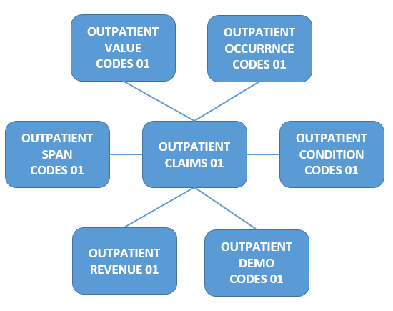
Data Model – CCW RIF
SAS Data Warehouse
Split by Seven Claim Types
Inpatient
Outpatient
Skilled Nursing
Home Health
Hospice
Physician
Durable Equipment
1999 through 2017
By Month
~8400 SAS Data Sets ← Lends itself very well to SAS Grid processing!

Slide 60
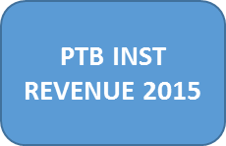
Data Model – CCW GVDB
SAS Data Warehouse
Highly De-normalized
Split between Part A, Part B, and Part D
PTA_CLAIM_{year}
PTA_REVENUE_{year}
PTB_INST_REVENUE_{year}
PTB_NONINST_LINE_{year}
PTD_EVENT_{year}
2006 through 2017
By Year

Slide 61
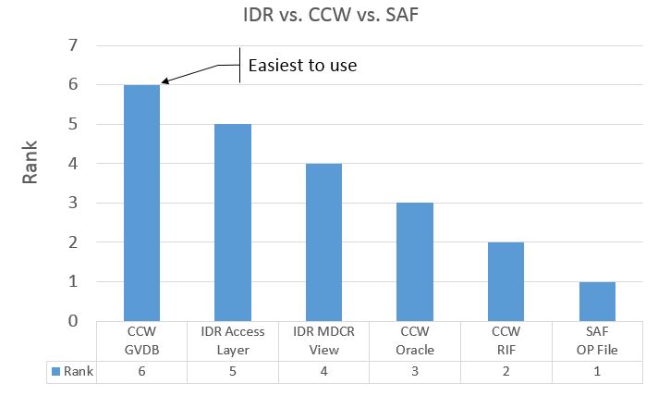
Ease of Use
Very subjective!
Actual mileage may very!!

Slide 62
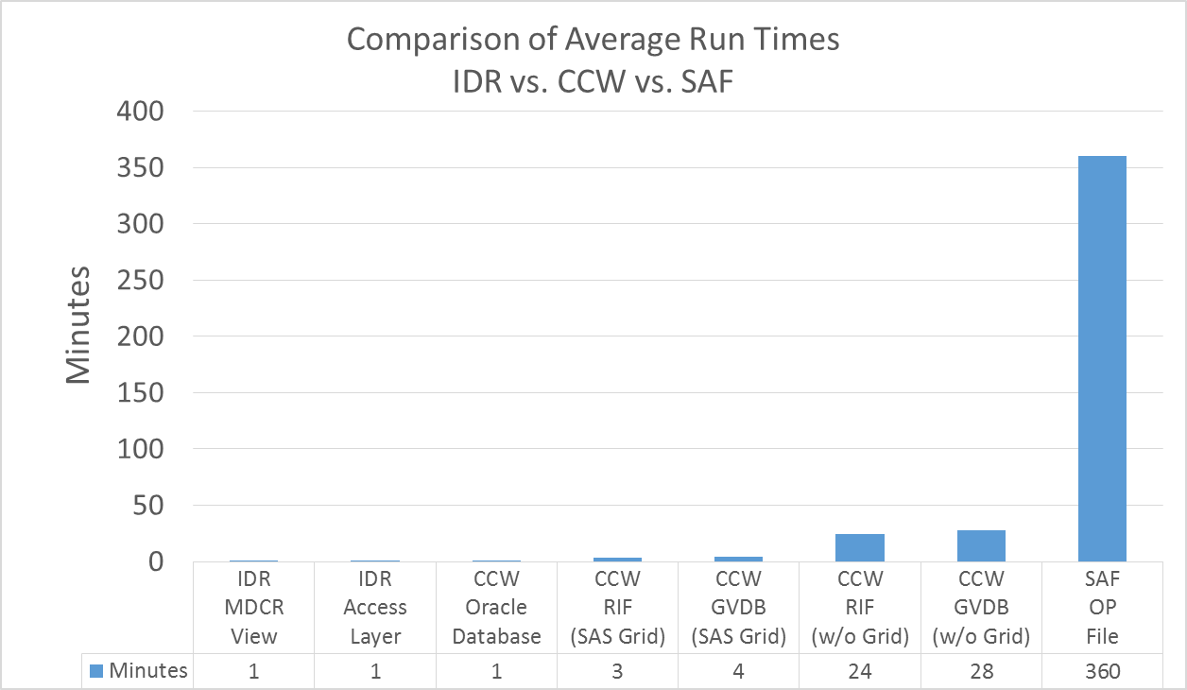
Average Run Times

Slide 63
CMS Contacts
ResDAC@umn.edu
ccwhelp@gdit.com
SasEbi@cms.hhs.gov
Desy_Support@cms.hhs.gov
CMSIDR_Support@cms.hhs.gov
Quadrant II Activities
CDUG: CDUG@cms.hhs.gov
SUG: SUG@cms.hhs.gov
IBUG: CMSIDR_Support@cms.hhs.gov
PIDUG: OnePIDUG@qssinc.com
CMS Toastmasters: http://8470.toastmastersclubs.org

Slide 64
Questions
Rick Andrews Office of the Actuary Centers for Medicare and Medicaid Services Richard.Andrews@cms.hhs.gov (410) 786-6395

